Slide 1
Threat Model Using STRIDE
Use case: Feedback Sharing System

Slide 2
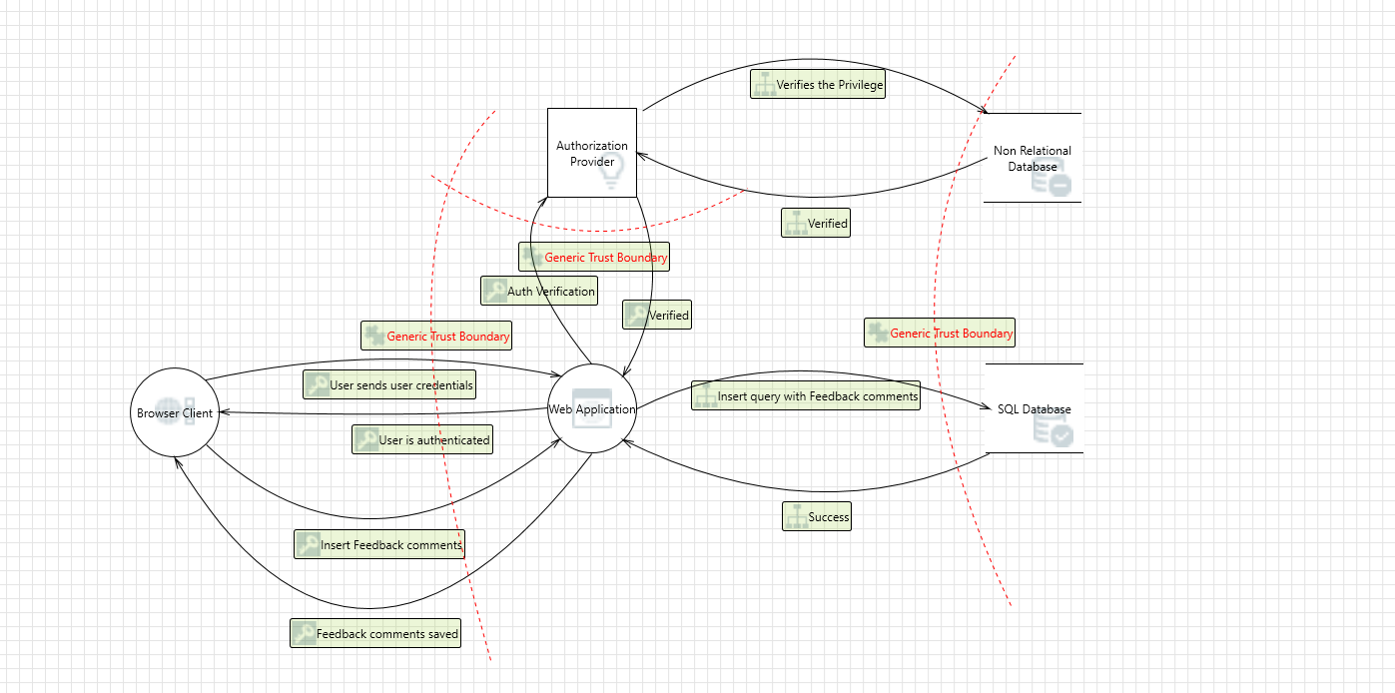
Flow Diagram of Feedback Sharing System

Slide 3
STRIDE Model:
Spoofing
Tampering
Repudiation
Information Disclosure
Denial of Service
Elevation of Privileges

Slide 4
Spoofing
Targets: Person/role, machine, file, process
Methods: Website spoofing (creating replica sites to steal credentials), MAC address spoofing (impersonating legitimate devices on a network), IP address spoofing (disguising the origin of network traffic).
Impacts: Data breaches, reputational damage, compromised systems, Financial loss (e.g., fraudulent transactions).
Mitigation: Strong authentication mechanisms (multi-factor authentication, digital certificates), user education on identifying spoofing attempts, network security monitoring.

Slide 5
Tampering
Targets: File/data, memory, network, process
Methods: Modifying files (documents, code, configurations), altering memory contents, manipulating network packets, injecting malicious code into processes.
Impacts: System instability, data corruption, unauthorized access, process interruptions.
Mitigation: Data integrity checks (hashing, digital signatures), memory protection mechanisms, network intrusion detection/prevention systems (IDS/IPS), process monitoring and sandboxing.

Slide 6
Repudiation
Targets: Logs, database, location of logs
Methods: Deleting or altering logs, corrupting databases, hiding location of logs to prevent accountability.
Impacts: Difficulty in incident response, forensic analysis, and recovering from attacks, potential legal and regulatory issues.
Mitigation: Secure log storage with tamper-evident mechanisms, immutable databases, regular backups, log forwarding, centralized log management.

Slide 7
Information Disclosure
Targets: Data stores, data in transit, data in memory, data within a process, data within a file/device
Methods: Unauthorized access to databases, eavesdropping on network traffic, memory scraping, process injection, malware exfiltration.
Impacts: Data breaches, privacy violations, loss of confidential information, financial losses, compliance issues.
Mitigation: Data encryption, access controls, network segmentation, data loss prevention (DLP), regular security assessments and incident response plans.

Slide 8
Denial of Service (DoS)
Targets: Process (Web Application), data store, data flow, network
Methods: Flooding systems with requests, consuming resources, exploiting vulnerabilities, targeting network infrastructure.
Impacts: Service disruptions, financial losses, downtime, damage to reputation, user frustration.
Mitigation: Rate limiting, resource monitoring, DDoS mitigation solutions, network security filtering, redundancy and failover mechanisms.

Slide 9
Elevation of Privilege
Targets: Compromising a process, circumventing authorization, tampering data
Methods: Exploiting LDAP vulnerabilities, social engineering, brute-force attacks, password spraying.
Impacts: Unauthorized access to sensitive systems, data theft, disruption of operations, privilege escalation attacks.
Mitigation: Least privilege principle (granting only necessary permissions), strong password policies, patch management, application whitelisting, user education on secure practices, network segmentation.

